Slide 1
Telephone System
Prepared By: Er. Amit Kr. Tewari
Associate Professor
CS Dept.
ACEIT, Jaipur

Slide 2
Introduction
The original telephone system was designed for full duplex analog communication of voice signals.
Today, the telephone system is still primarily used for voice, but it employs mostly digital techniques, not only in signal transmission but also in control operations.
The telephone system permits any telephone to connect with any other telephone in the world.
This means that each telephone must have a unique identification code—the 10-digit telephone number assigned to each telephone.
The telephone system provides a means of recognizing each individual number and provides switching systems that can connect any two telephones.

Slide 3
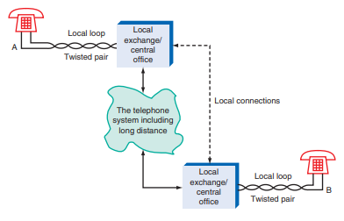
Basic Telephone System

Slide 4
Telephone System Introduction
When we refer to the telephone system, we are talking about the organizations and facilities involved in connecting your telephone to the called telephone regardless of where it might be in anywhere else in the world.
The telephone system is called the Public Switched Telephone Network (PSTN).

Slide 5
Contd…
A number of different companies are involved in long-distance calls, although a single company is usually responsible for local calls in a given area.
These companies make up the telephone system, and they design, build, maintain, and operate all the facilities and equipment used in providing universal telephone service.
The telephone, a small but relatively complex entity, is nothing compared to the massive system that backs it up.
The telephone system can connect any two telephones in the world, and most people can only speculate on the method by which this connection takes place.
It takes place on many levels and involves an incredible array of systems and technology.
Obviously, it is difficult to describe such a massive system here.

Slide 6
Telephone system Subscriber Interface
Most telephones are connected to a local central office by way of the two-line, twisted-pair local loop cable.
The central office contains all the equipment that operates the telephone and connects it to the telephone system that makes the connection to any other telephone.
Most telephones are connected to a local central office by way of the two-line, twisted pair local loop cable.
The central office contains all the equipment that operates the telephone and connects it to the telephone system that makes the connection to any other telephone

Slide 7
Telephone system Subscriber Interface (Cotnd…)
Each telephone connected to the central offi ce is provided with a group of basic circuits that power the telephone and provide all the basic functions, such as ringing, dial tone, and dialing supervision.
These circuits are collectively referred to as the subscriber interface or the subscriber line interface circuit (SLIC).

Slide 8
Functions of Subscriber Line Interface Circuit (SLIC)
Battery
Overvoltage Protection
Ringing
Supervision
Coding
Hybrid
Test Signals
BORSCHT Functions

Slide 9
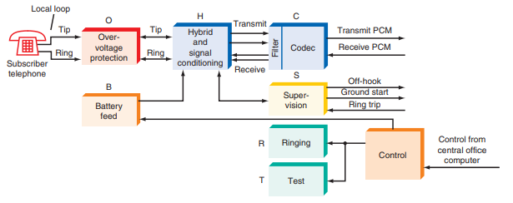
BORSCHT functions in the subscriber line interface at the central office

Slide 10
Battery
The subscriber line interface at the central office must provide a dc voltage to the subscriber to operate the telephone.
In the United States, this is typically 248 V dc with respect to ground.
The actual voltage can be anything between approximately 220 and 280 V when the phone is on the hook, i.e., disconnected.
The voltage at the telephone drops to approximately 6 V when the phone is taken off the hook.

Slide 11
Overvoltage Protection
The circuits and components that protect the subscriber line interface circuits from electrical damage are referred to collectively as overvoltage protection.
The phone lines are vulnerable to many types of electrical problems.
Overvoltage protection ensures reliable telephone operation even under such conditions.

Slide 12
Ringing
When a specific telephone is receiving a call, the telephone local office must provide a ringing signal.
As indicated earlier, this is commonly a 90-Vrms ac signal at approximately 20 Hz.
The SLIC must connect the ringing signal to the local loop when a call is received.

Slide 13
Supervision
Supervision refers to a group of functions within the subscriber line interface that monitor local loop conditions and provide various services.
For example, the supervision circuits in the SLIC detect when a telephone is picked up to initiate a new call.
A sensing circuit recognizes the off-hook condition and signals circuits within the SLIC to connect a dial tone.
The caller then dials the desired number, which causes interconnection through the telephone system.
The supervision circuits continuously monitor the line during the telephone call.
The circuits sense when the call is terminated and provide the connection of a busy signal if the called number is not available.

Slide 14
Coding
Coding is another name for A/D conversion and D/A conversion. Today, many telephone transmissions are made by way of serial digital data methods.
The SLIC may contain codec that converts the analog voice signals to serial PCM format or converts received digital calls back to analog signals to be placed on the local loop.
Transmission over trunk lines to other central offices or toll offices or for use in long-distance transmission is typically by digital PCM signals in modern systems.

Slide 15
Hybrid
The hybrid combines the signal from the telephone transmitter with the received signal to the receiver on the single twisted-pair cable.
It keeps the signals separate within the telephone.
A hybrid is also used at the central office.
It effectively translates the two-wire line to the subscriber back into four lines, two each for the transmitted and received signals.
The hybrid provides separate transmit and receive signals.

Slide 16
Test Signals
To check the status and quality of subscriber lines, the phone company often puts special test tones on the local loop and receives resulting tones in return.
These can give information about the overall performance of the local loop.
The SLIC provides a way to connect the test signals to the local loop and to receive the resulting signals for measurement.

Slide 17
BORSCHT Functions
The basic BORSCHT functions are usually divided into two groups, high voltage and low voltage.
The high-voltage parts of the system are the battery feed, overvoltage protection, ringing circuits, and test circuits. The low-voltage group includes the supervision, coding, and hybrid functions.
Single-chip SLIC BORSCHT ICs are now available.

